Slide 1
Computer Architecture 1
Computer Organization and Design T H E H A R D W A R E / S O F T W A R E I N T E R F A C E
[Adapted from Computer Organization and Design, RISC-V Edition, Patterson & Hennessy, © 2018, MK] [Adapted from Great ideas in Computer Architecture (CS 61C) lecture slides, Garcia and Nikolíc, © 2020, UC Berkeley]

Slide 2
RISC-V Processor Design

Slide 3


Great Idea #1: Abstraction
(Levels of Representation/Interpretation)
High Level Language Program (e.g., C)
 | Compiler
Assembly Language Program (e.g., RISC-V)
 | Assembler
Machine Language Program (RISC-V)
Hardware Architecture Description (e.g., block diagrams)
 | Architecture Implementa
Logic Circuit Description (Circuit Schematic Diagrams)
temp = v[k]; v[k] = v[k+1]; v[k+1] = temp;
lw
x3, 0(x10)
x4, 4(x10)
x4, 0(x10)
x3, 4(x10)
01 1110 0010 0000 0000 0000 0000
lw sw sw
1000 11
1000 1110 0001 0000 0000 0000 0000 0100
1010 1110 0001 0010 0000 0000 0000 0000
1010 1101 1110 0010 0000 0000 0000 0100
+4
Reg []
pc
pc+4
alu
alu ¹
pc
^{wb} DataD
1
Reg[rs1] _{ALU}
0
DMEM
2
pc+4
0
IMEM
inst[11:7] _{AddrD}
Branch Comp.
Reg[rs2]
0
1
Addr
DataR
1
wb
inst[19:15] AddrA DataA
DataW
mem
0
tion
inst[24:20] AddrB DataB
inst[31:7] _{Imm.}
Gen
imm [31:0]
A B
Out = AB+CD
C D

Slide 4
Our Single-Core Processor So Far…
Processor
Memory
Input
Control
Enable? Read/Write
Program
Address
Datapath
Program Counter (PC)
Registers
Bytes
Write Data
Data
Read Data
Output
Arithmetic-Logic Unit (ALU)

Slide 5
The CPU
Processor (CPU): the active part of the computer that does all the work (data manipulation and decision-making)
Datapath: portion of the processor that contains hardware necessary to perform operations required by the processor (the brawn)
Control: portion of the processor (also in hardware) that tells the datapath what needs to be done (the brain)

Slide 6

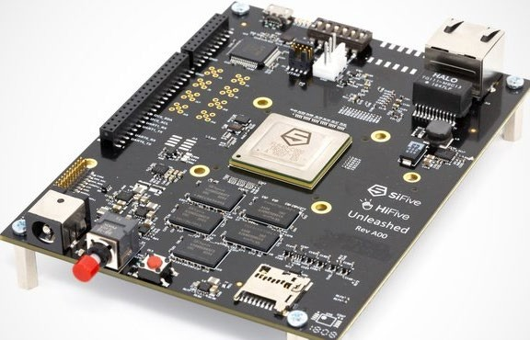


Need to Implement All RV32I Instructions
Open Reference Card
Base Integer Instructions: RV32I
Category Name | Fmt | RV32I Base | Category Name | Fmt | RV32I Base
Shifts Shift Left Logical | R | SLL rd,rs1,rs2 | Loads Load Byte | I | LB rd,rs1,imm
Shift Left Log. Imm. | I | SLLI rd,rs1,shamt | Load Halfword | I | LH rd,rs1,imm
Shift Right Logical | R | SRL rd,rs1,rs2 | Load Byte Unsigned | I | LBU rd,rs1,imm
Shift Right Log. Imm. | I | SRLI rd,rs1,shamt | Load Half Unsigned | I | LHU rd,rs1,imm
Shift Right Arithmetic | R | SRA rd,rs1,rs2 | Load Word | I | LW rd,rs1,imm
Shift Right Arith. Imm. | I | SRAI rd,rs1,shamt | Stores Store Byte | S | SB rs1,rs2,imm
Arithmetic ADD | R | ADD rd,rs1,rs2 | Store Halfword | S | SH rs1,rs2,imm
ADD Immediate | I | ADDI rd,rs1,imm | Store Word | S | SW rs1,rs2,imm
SUBtract | R | SUB rd,rs1,rs2 | Branches Branch = | B | BEQ rs1,rs2,imm
Load Upper Imm | U | LUI rd,imm | Branch ≠ | B | BNE rs1,rs2,imm
Add Upper Imm to PC | U | AUIPC rd,imm | Branch < | B | BLT rs1,rs2,imm
Logical XOR | R | XOR rd,rs1,rs2 | Branch ≥ | B | BGE rs1,rs2,imm
XOR Immediate | I | XORI rd,rs1,imm | Branch < Unsigned | B | BLTU rs1,rs2,imm
OR | R | OR rd,rs1,rs2 | Branch ≥ Unsigned | B | BGEU rs1,rs2,imm
OR Immediate | I | ORI rd,rs1,imm | Jump & Link J&L | J | JAL rd,imm
AND | R | AND rd,rs1,rs2 | Jump & Link Register | I | JALR rd,rs1,imm
AND Immediate | I | ANDI rd,rs1,imm
Compare Set < | R | SLT rd,rs1,rs2 | Synch Synch thread | I | FENCE
Set < Immediate | I | SLTI rd,rs1,imm |  |  | Not in
Set < Unsigned | R | SLTU rd,rs1,rs2 | Environment CALL | I | ECALL _{61C}
Set < Imm Unsigned | I | SLTIU rd,rs1,imm | BREAK | I | EBREAK

Slide 7


Slide 8
Máy RISC-V một lệnh trên mỗi chu kỳ
Trong mỗi tích tắc của đồng hồ, máy tính sẽ thực hiện một lệnh
Các đầu ra trạng thái hiện tại điều khiển các đầu vào tới logic tổ hợp, đầu ra của nó ổn định ở các giá trị của trạng thái trước cạnh đồng hồ tiếp theo
Ở cạnh xung nhịp tăng, tất cả các phần tử trạng thái được cập nhật với các đầu ra logic tổ hợp và quá trình thực thi sẽ chuyển sang chu kỳ xung nhịp tiếp theo
Combinational Logic

Slide 9
PC (Program Counter):
Chức năng: Thanh ghi này chứa địa chỉ của lệnh hiện tại đang được xử lý trong bộ nhớ chương trình (IMEM). PC cập nhật sau mỗi lệnh để trỏ đến lệnh tiếp theo.
IMEM (Instruction Memory):
Chức năng: Bộ nhớ chứa các lệnh của chương trình. Địa chỉ được trỏ bởi PC được sử dụng để tải lệnh từ IMEM.
Reg[] (Registers):
Chức năng: Mảng thanh ghi chứa dữ liệu có thể được sử dụng trong các phép tính. Các lệnh có thể đọc dữ liệu từ các thanh ghi này hoặc ghi kết quả vào chúng.
DMEM (Data Memory):
Chức năng: Bộ nhớ chứa dữ liệu mà chương trình sử dụng, chẳng hạn như biến hoặc mảng. Các lệnh như load và store sẽ tương tác với DMEM để lấy hoặc cập nhật dữ liệu.
Combinational Logic:
Chức năng: Đây là nơi xử lý các lệnh, bao gồm tính toán địa chỉ tiếp theo của PC, giải mã lệnh, và thực hiện các phép tính hoặc so sánh dựa trên lệnh hiện tại và/hoặc dữ liệu từ các thanh ghi. Logic tổ hợp phản ánh thiết kế của đơn vị xử lý trung tâm (CPU), xử lý tất cả các hoạt động tính toán và điều khiển dựa trên lệnh.
Clock (Đồng hồ):
Chức năng: Đồng hồ cung cấp tín hiệu nhịp để đồng bộ hóa tất cả các hoạt động trong máy tính. Mỗi xung nhịp đồng hồ cho phép bước tiếp theo trong chu kỳ lệnh được thực hiện.
Kiến trúc này cho thấy quá trình thực thi lệnh từ lấy lệnh ở IMEM, giải mã và thực thi ở logic tổ hợp, và tương tác với bộ nhớ dữ liệu (DMEM) nếu cần. PC, IMEM, và các thanh ghi là cơ bản cho việc xác định lệnh tiếp theo và cung cấp dữ liệu cần thiết để thực thi chúng, trong khi DMEM được sử dụng để lưu trữ và truy cập dữ liệu runtime(dữ liệu thời gian chạy,-Biến động trong chương trình, cấp phát động) .

Slide 10
Stages of the Datapath : Overview
Problem: a single, “monolithic” block that “executes an instruction” (performs all necessary operations beginning with fetching the instruction) would be too bulky and inefficient
Solution: break up the process of “executing an instruction” into stages, and then connect the stages to create the whole datapath
smaller stages are easier to design
easy to optimize (change) one stage without touching the others (modularity) --- module hóa

Slide 11
Five Stages of the Datapath
Stage 1: Instruction Fetch (IF) tìm nạp lệnh
Stage 2: Instruction Decode (ID) giải mã lệnh
Stage 3: Execute (EX) - ALU (Arithmetic-Logic Unit) – thực thi
Stage 4: Memory Access (MEM) – truy cập bộ nhớ
Stage 5: Write Back to Register (WB) viết lại vào thanh ghi

Slide 12









Basic Phases of Instruction Execution
rd
Reg[ ]
PC
IMEM
rs1 rs2
DMEM
ALU
+4
imm
mux
1. Instruction Fetch
2. Decode/ Register Read
5. Register
4. Memory
3. Execute
Write
Access
Clock
time

Slide 13
Datapath Components: Combinational
Combinational elements
OP
CarryIn
Select
A
32
A
Adder
A
32
Sum
32
MUX
ALU
Result
32
32
Y
32
B
32
CarryOut B
32
B
32
Adder
Multiplexer
ALU
Storage elements + clocking methodology
Building blocks

Slide 14
Datapath Elements: State and Sequencing (1/3)
Write Enable
Data In
Data Out
Register
Write Enable:
N
N
clk
Low (or deasserted) (0): Data Out will not change
Asserted (1): Data Out will become Data In on positive edge of clock

Slide 15
Datapath Elements: State and Sequencing (2/3)
RW RA RB 5 5 5
Register file (regfile, RF) consists of 32 registers:
Two 32-bit output busses: busA and busB
One 32-bit input bus: busW
Register is selected by:
RA (number) selects the register to put on busA (data)
RB (number) selects the register to put on busB (data)
RW (number) selects the register to be written via busW (data) when Write Enable is 1
Clock input (Clk)
Clk input is a factor ONLY during write operation
During read operation, behaves as a combinational logic block:
RA or RB valid ⇒ busA or busB valid after “access time.”
Write Enable
32 x 32-bit Registers
busA
busW
32
32
busB
Clk
32

Slide 16
Datapath Elements: State and Sequencing (3/3)
“Magic” Memory
Write Enable Address
Data In DataOut
32 32
Clk
One input bus: Data In
One output bus: Data Out
Memory word is found by:
For Read: Address selects the word to put on Data Out
For Write: Set Write Enable = 1: address selects the memory word to be written via the Data In bus
Clock input (CLK)
CLK input is a factor ONLY during write operation
During read operation, behaves as a combinational logic block: Address valid ⇒ Data Out valid after “access time”

Slide 17
State Required by RV32I ISA (1/2)
Each instruction during execution reads and updates the state of :
(1) Registers, (2) Program counter, (3) Memory
Registers (x0..x31)
Register file (regfile) Reg holds 32 registers x 32 bits/register:
Reg[0]..Reg[31]
First register read specified by rs1 field in instruction
Second register read specified by rs2 field in instruction
Write register (destination) specified by rd field in instruction
x0 is always 0 (writes to Reg[0]are ignored)
Program Counter (PC)
Holds address of current instruction

Slide 18
State Required by RV32I ISA (2/2)
Memory (MEM)
Holds both instructions & data, in one 32-bit byte-addressed memory space
We’ll use separate memories for instructions (IMEM) and data (DMEM)
These are placeholders for instruction and data caches
Instructions are read (fetched) from instruction memory (assume IMEM read-only)
Load/store instructions access data memory

Slide 19


Slide 20
Review: R-Type Instructions
3
1
 | 30 | 29 | 28 | 27 | 26 | 25 | 24 | 23 | 22 | 21 | 20 | 19 | 18 | 17 | 16 | 15 | 14 | 13 | 12 | 10 | 9 | 8 | 7 | 6 | 5 | 4 | 3 | 2 | 1 | 0
R-format : ALU
[31:25] |  |  |  |  |  |  | [24:20] |  |  |  |  | [19:15] |  |  |  |  | [14:12] |  |  | [11:7] |  |  |  | [6:0]
7 |  |  |  |  |  |  | 5 |  |  |  |  | 5 |  |  |  |  | 3 |  |  | 5 |  |  |  | 7
func7 |  |  |  |  |  |  | rs2 |  |  |  |  | rs1 |  |  |  |  | func3 |  |  | rd |  |  |  | opcode
0000000 |  |  |  |  |  |  | rs2 |  |  |  |  | rs1 |  |  |  |  | 000 : ADD |  |  | rd |  |  |  | 0110011:OP-R
0100000 |  |  |  |  |  |  | rs2 |  |  |  |  | rs1 |  |  |  |  | 000 : SUB |  |  | rd |  |  |  | 0110011:OP-R
0000000 |  |  |  |  |  |  | rs2 |  |  |  |  | rs1 |  |  |  |  | 001 : SLL |  |  | rd |  |  |  | 0110011:OP-R
0000000 |  |  |  |  |  |  | rs2 |  |  |  |  | rs1 |  |  |  |  | 010 : SLT |  |  | rd |  |  |  | 0110011:OP-R
0000000 |  |  |  |  |  |  | rs2 |  |  |  |  | rs1 |  |  |  |  | 011 : SLTU |  |  | rd |  |  |  | 0110011:OP-R
0000000 |  |  |  |  |  |  | rs2 |  |  |  |  | rs1 |  |  |  |  | 100 : XOR |  |  | rd |  |  |  | 0110011:OP-R
0000000 |  |  |  |  |  |  | rs2 |  |  |  |  | rs1 |  |  |  |  | 101 : SRL |  |  | rd |  |  |  | 0110011:OP-R
0100000 |  |  |  |  |  |  | rs2 |  |  |  |  | rs1 |  |  |  |  | 101 : SRA |  |  | rd |  |  |  | 0110011:OP-R
0000000 |  |  |  |  |  |  | rs2 |  |  |  |  | rs1 |  |  |  |  | 110 : OR |  |  | rd |  |  |  | 0110011:OP-R
0000000 |  |  |  |  |  |  | rs2 |  |  |  |  | rs1 |  |  |  |  | 111 : AND |  |  | rd |  |  |  | 0110011:OP-R
E.g. Addition/subtraction add rd, rs1, rs2
R[rd] = R[rs1] + R[rs2] sub rd, rs1, rs2
R[rd] = R[rs1] - R[rs2]

Slide 21
Implementing the add instruction
31 25 24 20 19 1514 12 11
7 5 5 3
31 25 24 20 19 1514 12 11
76
0
funct7 | rs2 | rs1 | funct3 | rd | opcode
5
7
76
0
0000000 | rs2 | rs1 | 000 | rd | 0110011
7
add
5
rs2
5
rs1
3
add
5
rd
7
Reg-Reg OP
add rd, rs1, rs2
Instruction makes two changes to machine’s state:
Reg[rd] = Reg[rs1] + Reg[rs2]
PC = PC + 4

Slide 22
Datapath for add
Reg[rd] = Reg[rs1] + Reg[rs2]
+4
Add
DataD
Inst[11:7]
AddrD AddrA
AddrB
PC
addr
Inst[19:15]
Reg[rs1]
pc+4
inst
DataA
+
alu
Inst[24:20]
Reg[rs2]
ALU
clk
DataB
IMEM
Reg [ ]
Inst[31:0]
clk
RegWriteEnable (RegWEn) =1
1514 12 11
Control logic
31
25 24
20 19
76
0
funct7 | rs2 | rs1 | funct3 | rd | opcode
7
5
5
3
5
7

Slide 23

Timing Diagram for add
+4
Add
DataD
Inst[11:7]
PC
addr
Inst[19:15]
AddrD
Reg[rs1]
pc+4
inst
AddrA
DataA
+
alu
Inst[24:20]
AddrB
Reg [ ]
DataB
Reg[rs2]
ALU
clk
IMEM
clk
Inst[31:0]
RegWEn
Clock
PC
1000
1004
PC+4
1004
1008
inst[31:0]
add x1,x2,x3
add x6,x7,x9
Reg[rs1]
Reg[rs2] alu
Reg[2]
Reg[7]
Reg[3]
Reg[9]
Reg[2]+Reg[3]
Reg[7]+Reg[9]
Reg[1]
???
Reg[2]+Reg[3]
time

Slide 24


Slide 25





Implementing the sub instruction
0000000 | rs2 | rs1 | 000 | rd | 0110011 | add
0100000 | rs2 | rs1 | 000 | rd | 0110011 | sub
sub rd, rs1, rs2
Almost the same as add, except now have to subtract operands instead of adding them
inst[30] selects between add and subtract

Slide 26
Datapath for add/sub
PC = PC + 4
Reg[rd] = Reg[rs1] +/- Reg[rs2]
+4
Add
DataD
PC
Inst[11:7]
AddrD AddrA
Reg[rs1]
pc+4
addr
Inst[19:15]
inst
DataA
alu
Inst[24:20]
Reg[rs2]
ALU
clk
AddrB
DataB
IMEM
Reg [ ]
Inst[31:0]
clk
RegWriteEnable (RegWEn) =1
1514 12 11
ALUSel (add=0/sub=1)
Control logic
31
25 24
20 19
76
0
0100000 | rs2 | rs1 | 000 | rd | 0110011
7
5
5
3
5
7

Slide 27





Implementing Other R-Format Instructions
0000000 | rs2 | rs1 | 000 | rd | 0110011 | add
0100000 | rs2 | rs1 | 000 | rd | 0110011 | sub
0000000 | rs2 | rs1 | 001 | rd | 0110011 | sll
0000000 | rs2 | rs1 | 010 | rd | 0110011 | slt
0000000 | rs2 | rs1 | 011 | rd | 0110011 | sltu
0000000 | rs2 | rs1 | 100 | rd | 0110011 | xor
0000000 | rs2 | rs1 | 101 | rd | 0110011 | srl
0100000 | rs2 | rs1 | 101 | rd | 0110011 | sra
0000000 | rs2 | rs1 | 110 | rd | 0110011 | or
0000000 | rs2 | rs1 | 111 | rd | 0110011 | and
All implemented by decoding funct3 and funct7 fields and selecting appropriate ALU function

Slide 28


Slide 29




Implementing I-Format - addi instruction
RISC-V Assembly Instruction:
addi x15,x1,-50
31 20 19 1514 12 11 76
12 5 3 5
0
imm[11:0] | rs1 | funct3 | rd | opcode
7
111111001110 00001 000
imm=-50 rs1=1 add
01111
rd=15
0010011
OP-Imm

Slide 30


Datapath for add/sub
PC = PC + 4
Reg[rd] = Reg[rs1] + Imm
+4
Add
DataD
PC
Inst[11:7]
AddrD AddrA
Reg[rs1]
pc+4
addr
Inst[19:15]
inst
DataA
alu
Inst[24:20]
Reg[rs2]
ALU
clk
AddrB
DataB
IMEM
Reg [ ]
Inst[31:0]
clk
RegWriteEnable (RegWEn)
=1
ALUSel (add=0/sub=1)
Control logic
Immediate should be here

Slide 31
Adding addi to Datapath
PC = PC + 4
Reg[rd] = Reg[rs1] + Imm
+4
Add
DataD
PC
Inst[11:7]
AddrD AddrA
AddrB
Reg[rs1]
pc+4
addr
Inst[19:15]
inst
DataA
alu
Inst[24:20]
Reg[rs2]
ALU
clk
DataB
0
IMEM
Reg [ ]
1
Inst[31:0]
clk
Imm[31:0]
RegWriteEnable (RegWEn)=1
BSel (rs2=0/ Imm=1)
ALUSel (add=0/sub=1)
Control logic
31
20 19
1514
12 11
76
0
imm[11:0] | rs1 | 000 | rd | 0010011
12
5
3
5
7

Slide 32

Adding addi to Datapath
PC = PC + 4
Reg[rd] = Reg[rs1] + Imm
+4
Add
DataD
PC
Inst[11:7]
AddrD AddrA
AddrB
Reg[rs1]
pc+4
addr
Inst[19:15]
inst
DataA
alu
Inst[24:20]
Reg[rs2]
ALU
clk
DataB
0
IMEM
Reg [ ]
1
Inst
[31:20]
clk
Imm. Gen
Imm[31:0]
Inst[31:0]
ImmSel RegWriteEnable
=I (RegWEn)=1
BSel (rs2=0/ Imm=1)
ALUSel (add=0/sub=1)
Control logic

Slide 33












Adding addi to Datapath
PC = PC + 4
Reg[rd] = Reg[rs1] + Imm
+4
Add
DataD
Inst[11:7]
AddrD AddrA
AddrB
PC
addr
Inst[19:15]
Reg[rs1]
pc+4
inst
DataA
alu
Inst[24:20]
Reg[rs2]
ALU
clk
DataB
0
1
IMEM
Reg [ ]
Inst
[31:20]
clk
Bsel=1
Imm. Gen
Imm[31:0]
Inst[31:0]
ImmSel
=I
RegWriteEnable (RegWEn)=1
BSel (rs2=0/ Imm=1)
ALUSel (add=0/sub=1)
Control logic

Slide 34
I-Format Immediates
-inst[31]-
31 30
20 19
1514
12 11
76
0
 | imm[11:0] | rs1 | funct3 | rd |  | opcode
¹² inst[31:0]
--inst[31]-(sign-extension)-- |  |  |  |  | inst[30:20]
imm[31:0]
High 12 bits of instruction (inst[31:20])
inst[31:20] _{Imm.}
Gen
imm[31:0] copied to low 12 bits of immediate
(imm[11:0])
Immediate is sign-extended by copying value of inst[31] to fill the upper 20 bits of the immediate value (imm[31:12])
ImmSel=I

Slide 35
Adding addi to Datapath
Works for all other I-format arithmetic instructions (slti,sltiu,andi,
+4
ori,xori,slli,srli, srai) just by changing ALUSel
Add
DataD
PC
Inst[11:7]
AddrD AddrA
AddrB
Reg[rs1]
pc+4
addr
Inst[19:15]
inst
DataA
alu
Inst[24:20]
Reg[rs2]
ALU
clk
DataB
0
IMEM
Reg [ ]
1
Inst
[31:20]
clk
Imm.
Gen
Imm[31:0]
Inst[31:0]
ImmSel RegWriteEnable
=I (RegWEn)=1
BSel (rs2=0/ Imm=1)
ALUSel
Control logic

Slide 36


Slide 37
R+I Arithmetic/Logic Datapath
+4
Add
DataD
PC
Inst[11:7]
AddrD AddrA
Reg[rs1]
pc+4
addr
Inst[19:15]
inst
DataA
alu
Inst[24:20]
Reg[rs2]
ALU
clk
AddrB
DataB
0
IMEM
Reg [ ]
1
Inst [31:20]
clk
Imm.
Gen
Imm[31:0]
Inst[31:0]
ImmSel
RegWriteEnable
BSel
ALUSel
Control logic
RISC-V (37)

Slide 38






Add lw
RISC-V Assembly Instruction (I-type):
lw x14, 8(x2)
31
20 19 1514
12 11 76
0
imm[11:0] | rs1 | funct3 | rd | opcode
12
offset[11:0]
000000001000
5
base
00010
3 5 7
width dest LOAD
010 01110 0000011
imm=+8 rs1=2 lw rd=14 LOAD
The 12-bit signed immediate is added to the base address in register rs1 to form the memory address
This is very similar to the add-immediate operation but used to create address not to create final result
The value loaded from memory is stored in register rd
RISC-V (38)

Slide 39
R+I Arithmetic/Logic Datapath
+4
Add
DataD
PC
Inst[11:7]
alu
1
addr
AddrD
Reg[rs1]
0
pc+4
inst
Inst[19:15]
AddrA AddrB
DataA
DataR addr
Inst[24:20]
ALU
DataB
Reg[rs2]
clk
0
IMEM
Reg [ ]
1
DMEM
Inst
clk
Imm. Gen
clk
[31:20]
Imm[31:0]
Inst[31:0]
ImmSel
RegWriteEnable
BSel
ALUSel MemRW WBSel
Control logic
RISC-V (39)

Slide 40
















R+I Arithmetic/Logic Datapath
+4
Add
DataD
Inst[11:7]
alu
1
PC
addr
AddrD
Reg[rs1]
pc+4
inst
Inst[19:15]
AddrA AddrB
DataA
DataR addr
0
Inst[24:20]
ALU
DataB
Reg[rs2]
clk
0
IMEM
Reg [ ]
1
DMEM
Inst
clk
Imm. Gen
clk
[31:20]
Imm[31:0]
Inst[31:0]
ImmSel
=I
RegWEn=1
BSel=1
ALUSel
=Add
MemRW
=Read
WBSel
=0
Control logic
RISC-V (40)

Slide 41





All RV32 Load Instructions
imm[11:0] | rs1 | 000 | rd | 0000011 | lb
imm[11:0] | rs1 | 001 | rd | 0000011 | lh
imm[11:0] | rs1 | 010 | rd | 0000011 | lw
imm[11:0] | rs1 | 100 | rd | 0000011 | lbu
imm[11:0] | rs1 | 101 | rd | 0000011 | lhu
funct3 field encodes size and ‘signedness’ of load data
Supporting the narrower loads requires additional logic to extract the correct byte/halfword from the value loaded from memory, and sign- or zero-extend the result to 32 bits before writing back to register file.
It is just a mux + a few gates
RISC-V (41)

Slide 42


Slide 43








Adding sw instruction
sw: Reads two registers, rs1 for base memory address, and rs2 for data to be stored, as well immediate offset!
sw x14, 8(x2)
31 25 24
7
offset[11:5]
20 19 1514 12 11 76
0
Imm[11:5] | rs2 | rs1 | funct3 | imm[4:0] | opcode
5 5
src base
3 5
width offset[4:0]
7
STORE
0000000 01110
offset[11:5]
00010
010
01000 0100011
offset[4:0]
=8
=0
rs2=14
rs1=2
SW
STORE
0000000
01000
combined 12-bit offset = 8
RISC-V (43)

Slide 44
Datapath with lw
+4
Add
DataD
PC
Inst[11:7]
alu
1
addr
AddrD
Reg[rs1]
0
pc+4
inst
Inst[19:15]
AddrA AddrB
DataA
DataR addr
DMEM
Inst[24:20]
ALU
mem
DataB
Reg[rs2]
clk
0
IMEM
Reg [ ]
1
Inst
clk
Imm. Gen
clk
[31:20]
Imm[31:0]
Inst[31:0]
ImmSel
RegWriteEnable
BSel
ALUSel MemRW WBSel
Control logic
RISC-V (44)

Slide 45
Adding sw to Datapath
+4
Add
DataD
PC
Inst[11:7]
alu
1
addr
AddrD
Reg[rs1]
0
pc+4
inst
Inst[19:15]
AddrA AddrB
DataA
DataR addr
DMEM
DataW
Inst[24:20]
ALU
mem
DataB
Reg[rs2]
clk
0
IMEM
Reg [ ]
1
Inst
clk
Imm. Gen
clk
[31:20]
Imm[31:0]
Inst[31:0]
ImmSel
=S
RegWriteEnable
=0
Bsel
=1
ALUSel
=Add
MemRW WBSel
=Write
=*
Control logic
(don’t care)

Slide 46

Adding sw to Datapath
+4
Add
DataD
Inst[11:7]
alu
1
PC
addr
AddrD
Reg[rs1]
pc+4
inst
Inst[19:15]
AddrA AddrB
DataA
DataB addr
0
Inst[24:20]
ALU
mem
DataB
Reg[rs2]
clk
0
IMEM
Reg [ ]
DMEM
DataW
1
Inst
clk
[31:20]
Imm. Gen
Imm[31:0]
Inst[31:0]
ImmSel
=S
RegWEn=0
BSel=1
ALUSel
=Add
MemRW
=Write
WBSel
=*
Control logic
RISC-V (46)

Slide 47
I+S Immediate Generation
31 30 20 19
15 14
12 11
7 6
0
25 24
I
S
inst[31:0]
 | imm[11:0] |  | rs1 | funct3 | rd | I-opcode
 | imm[11:5] | rs2 | rs1 | funct3 | imm[4:0] | S-opcode
5
5
1
6
I/S
I S
inst[24:20]
inst[31] (sign extension)
inst[30:25]
I S
inst[31] (sign extension)
inst[30:25]
inst[11:7]
31
11 10
5 4
0
imm[31:0]
Just need a 5-bit mux to select between two positions where low five bits of immediate can reside in instruction
Other bits in immediate are wired to fixed positions in instruction
RISC-V (47)

Slide 48
All RV32 Store Instructions
Store byte writes the low byte to memory
Store halfword writes the lower two bytes to memory
sb sh sw
width
Imm[11:5] | rs2 | rs1 | 000 | imm[4:0] | 0100011
Imm[11:5] | rs2 | rs1 | 001 | imm[4:0] | 0100011
Imm[11:5] | rs2 | rs1 | 010 | imm[4:0] | 0100011
RISC-V (48)

Slide 49


Slide 50
RISC-V B-Format for Branches
31 30 25 24 2019 15 14 12 11 8 7 6
1 6 5 5 3 4 1 7
0
imm[12] | imm[10:5] | rs2 | rs1 | funct3 | imm[4:1] | imm[11] | opcode
offset[12|11:5] rs1
rs2
funct3 BRANCH
offset[4:1|11]
B-format is mostly same as S-Format, with two register sources (rs1/rs2) and a 12-bit immediate imm[12:1]
But now immediate represents values -4096 to +4094 in 2-byte increments
The 12 immediate bits encode even 13-bit signed byte offsets (lowest bit of offset is always zero, so no need to store it)

Slide 51
Datapath So Far
+4
Add
DataD
PC
Inst[11:7]
alu
1
addr
AddrD
Reg[rs1]
0
pc+4
inst
Inst[19:15]
AddrA AddrB
DataA
DataR addr
DMEM
DataW
Inst[24:20]
ALU
mem
DataB
Reg[rs2]
clk
0
IMEM
Reg [ ]
1
Inst
clk
Imm. Gen
clk
[31:20]
Imm[31:0]
Inst[31:0]
ImmSel
RegWriteEnable
BSel
ALUSel
MemRW
WBSel
Control logic

Slide 52
To Add Branches
Different change to the state:
PC = PC + 4, branch not taken PC + immediate, branch taken
Six branch instructions: beq, bne, blt, bge, bltu, bgeu
Need to compute PC + immediate and to compare values of rs1 and rs2
But have only one ALU – need more hardware

Slide 53
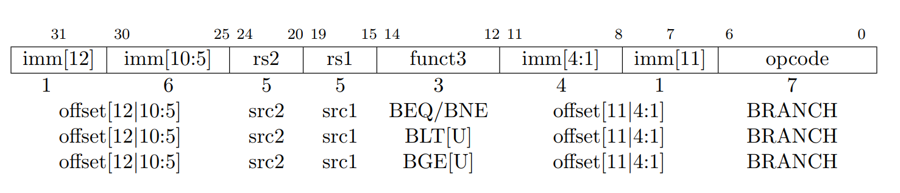

Slide 54
Adding Branches
+4
Add
pc+4
DataD
R[rs1]
0
Inst[11:7]
alu
1
PC
addr
inst
AddrD
1
0
1
pc
Inst[19:15]
AddrA AddrB
DataA
DataB
Inst[24:20]
Branch Comp
0
ALU
mem
DataB
addr
clk
0
IMEM
Reg [ ]
1
DMEM
Inst
clk
Imm. Gen
R[rs2]
clk
[31:20]
Imm[31:0]
PCSel= taken/not taken
Inst[31:0]
ImmSel
=B
RegWEn
=0
BrUn
BrLT ^{Bsel Asel} ALUSel
MemRW
=read
WBSel
=*
=1 =1
BrEq =add
Control logic

Slide 55
Branch Comparator
BrEq | = | 1, if A=B
BrLT | = | 1, if A<B
A B
Branch Comp
BrUn = 1 selects unsigned comparison for BrLT, 0=signed
BrU BrLT
BrEq
BGE branch: A >= B, if A<B
A<B = !(A<B)

Slide 56
Branch Immediates (In Other ISAs)
12-bit immediate encodes PC-relative offset of -4096 to +4094 bytes in multiples of 2 bytes
Standard approach: Treat immediate as in range -2048..+2047, then shift left by 1 bit to multiply by 2 for branches
s | imm[10:5] | rs2 | rs1 | funct3 | imm[4:0] | B-opcode
S-Immediate
B-Immediate (shift left by 1)
Each instruction immediate bit can appear in one of two places in output immediate value – so need one 2-way mux per bit
sign-extension | s | imm[10:5] | imm[4:0]
sign-extension | s | imm[10:5] | imm[4:0] | 0

Slide 57
Branch Immediates (In RISC -V ISAs)
12-bit immediate encodes PC-relative offset of -4096 to +4094 bytes in multiples of 2 bytes
NOTE : Page. 116 (RISC V Textbook -> get extra information)
RISC-V approach: keep 11 immediate bits in fixed position in output value, and rotate LSB of S-format to be bit 12 of B- format
S-Immediate
B-Immediate (shift left by 1)
Only one bit changes position between S and B, so only need a single-bit 2-way mux
sign=imm[11] | imm[10:5] | imm[4:0]
sign=imm[12] | imm[11] | imm[10:5] | imm[4:1] | 0
The RISC-V architects wanted to support the possibility of instructions that are only 2 bytes long, so the branch instructions represent the number of halfwords between the branch and the branch target

Slide 58
RISC-V Immediate Encoding
Instruction encodings, inst[31:0]
25 24 20 19 15 14 12 11
31
30
8 7 6
0
imm[11:0] | rs1 | funct3 | rd | opcode
I-type S-type
B-type
imm[11:5] | rs2 | rs1 | funct3 | imm[4:0] | opcode
imm[12|10:5] | rs2 | rs1 | funct3 | imm[4:1|11] | opcode
32-bit immediates produced, imm[31:0]
12 11 10 5 4
31
25 24
1
0
-inst[31]- | inst[30:25] | inst[24:21] | inst[20]
I-imm.
S-imm.
B-imm.
-inst[31]- | inst[30:25] | inst[11:8] | inst[7]
-inst[31]- | inst[7] | inst[30:25] | inst[11:8] | 0
Only bit 7 of instruction changes role in immediate between S and B
Upper bits sign-extended from inst[31] always

Slide 59



























Lighting Up Branch Path
+4
Add
pc+4
DataD
R[rs1]
0
Inst[11:7]
alu
1
PC
addr
inst
AddrD
1
0
1
pc
Inst[19:15]
AddrA AddrB
DataA
DataB
Inst[24:20]
Branch Comp
0
ALU
mem
DataB
addr
clk
0
IMEM
Reg [ ]
1
DMEM
Inst
clk
Imm. Gen
R[rs2]
clk
[31:20]
Imm[31:0]
PCSel= taken/not taken
Inst[31:0]
ImmSel
=B
RegWEn
=0
BrUn
BrLT ^{Bsel Asel} ALUSel
MemRW
=read
WBSel
=*
=1 =1
BrEq =add
Control logic
RISC-V (58)

Slide 60


Slide 61
Let’s Add JALR (I - Format)
31 20 19 15 14
12 11
7 6
0
imm[11:0] | rs1 | func3 | rd | opcode
12
offset[11:0]
5
base
3
0
5
dest
7
JALR
JALR rd, rs, immediate
Two changes to the state
Writes PC+4 to rd (return address)
Sets PC = rs1 + immediate
Uses same immediates as arithmetic and loads
no multiplication by 2 bytes
LSB is ignored
RISC-V (60)

Slide 62
Datapath So Far, With Branches
+4
Add
pc+4
DataD
R[rs1]
0
Inst[11:7]
alu
1
PC
addr
inst
AddrD
1
0
1
pc
Inst[19:15]
AddrA AddrB
DataA
DataB
Inst[24:20]
Branch Comp
0
ALU
mem
DataB
addr
clk
0
IMEM
Reg [ ]
1
DMEM
Inst
clk
Imm. Gen
R[rs2]
clk
[31:20]
Imm[31:0]
PCSel
Inst[31:0] ImmSel
Control logic
RegWEn
BrUn
BrLT ^{Bsel Asel} ALUSel
MemRW
WBSel
BrEq
RISC-V (61)

Slide 63
Datapath With JALR
+4
Add
pc+4
DataD
R[rs1]
2
0
Inst[11:7]
alu
1
PC
addr
AddrD
1
DataB addr
0
1
pc
inst
Inst[19:15]
AddrA AddrB
DataA
Inst[24:20]
Branch Comp
0
ALU
mem
clk
DataB
0
IMEM
Reg [ ]
1
DMEM
Inst
clk
Imm. Gen
R[rs2]
clk
[31:20]
Imm[31:0]
PCSel
=taken
Inst[31:0]
ImmSel
=I
RegWEn
=1
BrUn
BrLT ^{Bsel Asel} ALUSel
MemRW
=Read
WBSel
=2
^{=*} BrEq^{=*}
=*
=1
=0
=Add
Control logic
RISC-V (62)

Slide 64







Datapath With JALR
+4
Add
pc+4
DataD
R[rs1]
2
0
Inst[11:7]
alu
1
PC
addr
inst
AddrD
1
DataB addr
0
1
pc
Inst[19:15]
AddrA AddrB
DataA
Inst[24:20]
Branch Comp
0
ALU
mem
clk
DataB
0
IMEM
Reg [ ]
1
DMEM
Inst
clk
Imm. Gen
R[rs2]
clk
[31:20]
Imm[31:0]
PCSel
=taken
Inst[31:0]
ImmSel
=I
RegWEn
=1
BrUn
BrLT ^{Bsel Asel} ALUSel
MemRW
=Read
WBSel
=2
^{=*} BrEq^{=*}
=*
=1
=0
=Add
Control logic
RISC-V (63)

Slide 65


Slide 66
J-Format for Jump Instructions
31 30 21 20 19
12 11
7 6
0
imm[20] | imm[10:1] | imm[11] | imm[19:12] | rd | opcode
1
10 1 8
offset[20:1]
5
dest
7
JAL
Two changes to the state
jal saves PC+4 in register rd (the return address)
Set PC = PC + offset (PC-relative jump)
Target somewhere within ±2¹⁹ locations, 2 bytes apart
±2¹⁸ 32-bit instructions
Immediate encoding optimized similarly to branch instruction to reduce hardware cost
RISC-V (65)

Slide 67
Datapath with JAL
+4
Add
pc+4
DataD
R[rs1]
2
0
Inst[11:7]
alu
1
PC
addr
AddrD
1
DataB addr
0
1
pc
inst
Inst[19:15]
AddrA AddrB
DataA
Inst[24:20]
Branch Comp
0
ALU
mem
clk
DataB
0
IMEM
Reg [ ]
1
DMEM
Inst
clk
Imm.
Gen Imm[31:0]
R[rs2]
clk
[31:20]
PCSel
=taken
Inst[31:0]
ImmSel
=J
RegWEn
=1
BrUn
BrLT ^{Bsel Asel} ALUSel
MemRW
=Read
WBSel
=2
^{=*} BrEq^{=*}
=*
=1
=0
=Add
Control logic
RISC-V (66)

Slide 68


Light Up JAL Path
+4
Add
pc+4
DataD
R[rs1]
2
0
Inst[11:7]
alu
1
PC
addr
inst
AddrD
1
DataB addr
0
1
pc
Inst[19:15]
AddrA AddrB
DataA
Inst[24:20]
Branch Comp
0
ALU
mem
clk
DataB
0
IMEM
Reg [ ]
1
DMEM
Inst
clk
Imm.
Gen Imm[31:0]
R[rs2]
clk
[31:20]
PCSel
=taken
Inst[31:0]
ImmSel
=J
RegWEn
=1
BrUn
BrLT ^{Bsel Asel} ALUSel
MemRW
=Read
WBSel
=2
^{=*} BrEq^{=*}
=*
=1
=1
=Add
Control logic
RISC-V (67)

Slide 69


Slide 70
U-Format for “Upper Immediate” Instructions
31
12 11 7 6
5
dest dest
0
imm[31:12] | rd | opcode
20
U-immediate[31:12] U-immediate[31:12]
7
LUI AUIPC
Has 20-bit immediate in upper 20 bits of 32-bit instruction word
One destination register, rd
Used for two instructions
lui – Load Upper Immediate
auipc – Add Upper Immediate to PC
RISC-V (69)

Slide 71
Datapath With LUI, AUIPC
+4
Add
pc+4
DataD
R[rs1]
2
0
Inst[11:7]
alu
1
PC
addr
AddrD
1
DataB addr
0
1
pc
inst
Inst[19:15]
AddrA AddrB
DataA
Inst[24:20]
Branch Comp
0
ALU
mem
clk
DataB
0
IMEM
Reg [ ]
1
DMEM
Inst
clk
Imm.
Gen Imm[31:0]
R[rs2]
clk
[31:20]
PCSel
=pc+4
Inst[31:0]
ImmSel
=U
RegWEn
=1
BrUn
BrLT ^{Bsel Asel} ALUSel
MemRW
=Read
WBSel
=1
^{=*} BrEq^{=*}
=*
=1
=*
Control logic
RISC-V (70)

Slide 72



Lighting Up LUI
+4
Add
pc+4
DataD
R[rs1]
2
0
Inst[11:7]
alu
1
PC
addr
AddrD
1
DataB addr
0
1
pc
inst
Inst[19:15]
AddrA AddrB
DataA
Inst[24:20]
Branch Comp
0
ALU
mem
clk
DataB
0
IMEM
Reg [ ]
1
DMEM
Inst
clk
Imm.
Gen Imm[31:0]
R[rs2]
clk
[31:20]
PCSel
=pc+4
Inst[31:0]
ImmSel
=U
RegWEn
=1
BrUn
BrLT ^{Bsel Asel} ALUSel
MemRW
=Read
WBSel
=1
^{=*} BrEq^{=*}
=*
=1
=*
=B
Control logic
RISC-V (71)

Slide 73
Lighting Up AUIPC
+4
Add
pc+4
DataD
R[rs1]
2
0
Inst[11:7]
alu
1
PC
addr
AddrD
1
DataB addr
0
1
pc
inst
Inst[19:15]
AddrA AddrB
DataA
Inst[24:20]
Branch Comp
0
ALU
mem
clk
DataB
0
IMEM
Reg [ ]
1
DMEM
Inst
clk
Imm.
Gen Imm[31:0]
R[rs2]
clk
[31:20]
PCSel
=pc+4
Inst[31:0]
ImmSel
=U
RegWEn
=1
BrUn
BrLT ^{Bsel Asel} ALUSel
MemRW
=Read
WBSel
=1
^{=*} BrEq^{=*}
=*
=1
=*
=add
Control logic
RISC-V (72)

Slide 75
Complete RV32I Datapath!
+4
Add
pc+4
DataD
R[rs1]
2
0
Inst[11:7]
alu
1
PC
addr
AddrD
1
DataB addr
0
1
pc
inst
Inst[19:15]
AddrA AddrB
DataA
Inst[24:20]
Branch Comp
0
ALU
mem
clk
DataB
0
IMEM
Reg [ ]
1
DMEM
Inst
clk
Imm.
Gen Imm[31:0]
R[rs2]
clk
[31:20]
PCSel
Inst[31:0] ImmSel
Control logic
RegWEn
BrUn
BrLT ^{Bsel Asel} ALUSel
MemRW
WBSel
BrEq
RISC-V (74)

Slide 76


Complete RV32I ISA!
Open Reference Card
Base Integer Instructions: RV32I
Category Name | Fmt | RV32I Base | Category Name | Fmt | RV32I Base
Shifts Shift Left Logical | R | SLL rd,rs1,rs2 | Loads Load Byte | I | LB rd,rs1,imm
Shift Left Log. Imm. | I | SLLI rd,rs1,shamt | Load Halfword | I | LH rd,rs1,imm
Shift Right Logical | R | SRL rd,rs1,rs2 | Load Byte Unsigned | I | LBU rd,rs1,imm
Shift Right Log. Imm. | I | SRLI rd,rs1,shamt | Load Half Unsigned | I | LHU rd,rs1,imm
Shift Right Arithmetic | R | SRA rd,rs1,rs2 | Load Word | I | LW rd,rs1,imm
Shift Right Arith. Imm. | I | SRAI rd,rs1,shamt | Stores Store Byte | S | SB rs1,rs2,imm
Arithmetic ADD | R | ADD rd,rs1,rs2 | Store Halfword | S | SH rs1,rs2,imm
ADD Immediate | I | ADDI rd,rs1,imm | Store Word | S | SW rs1,rs2,imm
SUBtract | R | SUB rd,rs1,rs2 | Branches Branch = | B | BEQ rs1,rs2,imm
Load Upper Imm | U | LUI rd,imm | Branch ≠ | B | BNE rs1,rs2,imm
Add Upper Imm to PC | U | AUIPC rd,imm | Branch < | B | BLT rs1,rs2,imm
Logical XOR | R | XOR rd,rs1,rs2 | Branch ≥ | B | BGE rs1,rs2,imm
XOR Immediate | I | XORI rd,rs1,imm | Branch < Unsigned | B | BLTU rs1,rs2,imm
OR | R | OR rd,rs1,rs2 | Branch ≥ Unsigned | B | BGEU rs1,rs2,imm
OR Immediate | I | ORI rd,rs1,imm | Jump & Link J&L | J | JAL rd,imm
AND | R | AND rd,rs1,rs2 | Jump & Link Register | I | JALR rd,rs1,imm
AND Immediate | I | ANDI rd,rs1,imm
Compare Set < | R | SLT rd,rs1,rs2 | Synch Synch thread | I | FENCE
Set < Immediate | I | SLTI rd,rs1,imm |  |  | Not in
Set < Unsigned | R | SLTU rd,rs1,rs2 | Environment CALL | I | ECALL _{61C}
Set < Imm Unsigned | I | SLTIU rd,rs1,imm | BREAK | I | EBREAK
RISC-V (75)

Slide 77
Review
We have designed a complete datapath
Capable of executing all RISC-V instructions in one cycle each
Not all units (hardware) used by all instructions
5 Phases of execution
IF, ID, EX, MEM, WB
Not all instructions are active in all phases
Controller specifies how to execute instructions
We still need to design it
RISC-V (76)

Slide 78


Slide 79
Complete Single-Cycle RV32I Datapath!
+4
Add
pc+4
DataD
R[rs1]
2
0
Inst[11:7]
alu
1
PC
addr
inst
Inst[19:15] Inst[24:20]
AddrD
1
DataB addr
0
1
pc
AddrA
AddrB
DataA
0
Branch Comp
ALU
mem
clk
DataB
0
1
IMEM
Reg [ ]
DMEM
Inst
clk
Imm.
R[rs2]
clk
[31:20]
Gen Imm[31:0]
PCSel
Inst[31:0] ImmSel
Control logic
RegWEn ^{BrUn} BrLT ^{Bsel Asel} ALUSel MemRW WBSel
BrEq

Slide 80
Control and Status Registers
Control and status registers (CSRs) are separate from the register file (x0-x31)
Used for monitoring the status and performance
There can be up to 4096 CSRs
Not in the base ISA, but almost mandatory in every implementation
ISA is modular
Necessary for counters and timers, and communication with peripherals
Real Stuff: The Rest of the RISC-V System and Special Instructions
Page 464

Slide 81
CSR Instructions
31
20 19 1514
5 3
source instr uimm[4:0]
12 11
76
0
csr | rs1 | funct3 | rd | opcode
12
source/dest
5
rd
7
SYSTEM 1110011
Instr. | rd | rs | Read CSR? | Write CSR?
csrrw | x0 | - | no | yes
csrrw | !x0 | - | yes | yes
csrrs/c | - | x0 | yes | no
csrrs/c | - | !x0 | yes | yes

Slide 82
CSR Instructions
31
20 19 1514
5 3
source instr uimm[4:0]
12 11
76
0
csr | rs1 | funct3 | rd | opcode
12
source/dest
5
rd
7
SYSTEM
Zero-extended to 32b
Instr. | rd | uimm | Read CSR? | Write CSR?
csrrwi | x0 | - | no | yes
csrrwi | !x0 | - | yes | yes
csrrs/ci | - | 0 | yes | no
csrrs/ci | - | !0 | yes | yes

Slide 83
CSR Instruction Example
The CSRRW (Atomic Read/Write CSR) instruction ‘atomically’ swaps values in the CSRs and integer registers.
We will see more on ‘atomics’ later
CSRRW reads the previous value of the CSR and writes it to integer register rd. Then writes rs1 to CSR
Pseudoinstruction csrw csr, rs1 is
csrrw x0, csr, rs1
rd=x0, just writes rs1 to CSR
Pseudoinstruction csrwi csr, uimm is
csrrwi x0, csr, uimm
rd=x0, just writes uimm to CSR
Hint: Use write enable and clock…

Slide 84
System Instructions
ecall – (I-format) makes requests to supporting execution environment (OS), such as system calls (syscalls)
ebreak – (I-format) used e.g. by debuggers to transfer control to a debugging environment
31 20 19 1514 12 11 76
0
funct12 | rs1 | funct3 | rd | opcode
12
ECALL EBREAK
5
0
0
3
PRIV PRIV
5
0
0
7
SYSTEM
fence – sequences memory (and I/O) accesses as viewed by other threads or co-processors

Slide 85


Slide 86
Our Single-Core Processor
Processor
Memory
Input
Control
Enable? Read/Write
Program
 | Bytes
Data
Address
Datapath
Program Counter (PC)
Registers
Write Data
Read Data
Output
Arithmetic-Logic Unit (ALU)

Slide 87
Single-Cycle RV32I Datapath and Control
+4
Add
pc+4
DataD
R[rs1]
2
0
Inst[11:7]
alu
1
PC
addr
inst
Inst[19:15] Inst[24:20]
AddrD
1
DataB addr
0
1
pc
AddrA
AddrB
DataA
0
Branch Comp
ALU
mem
clk
DataB
0
1
IMEM
Reg [ ]
DMEM
Inst
clk
Imm.
R[rs2]
clk
[31:20]
Gen
Imm[31:0]
PCSel
Inst[31:0] ImmSel RegWEn
Control logic
^{BrUn} BrLT ^{Bsel Asel} ALUSel MemRW WBSel
BrEq

Slide 88



























Example: sw
+4
Add
pc+4
DataD
R[rs1]
2
0
1
Inst[11:7]
AddrD AddrA
AddrB
alu
1
PC
addr
inst
Inst[19:15] Inst[24:20]
1
0
DataB addr
0
pc
DataA
Branch Comp
ALU
mem
clk
DataB
0
1
IMEM
Reg [ ]
DMEM
Inst
clk
Imm.
R[rs2]
clk
[31:20]
Gen
Imm[31:0]
PCSel
=pc+4
Inst[31:0]
ImmSel RegWEn
=S =
Control logic 0
BrUn
BrLT ^{Bsel Asel} ALUSel
MemRW WBSel
=Write =*
=*
=*
=1
= 0
=add
BrEq =*

Slide 89







Example: beq
+4
Add
pc+4
DataD
R[rs1]
2
0
Inst[11:7]
alu
1
PC
addr
inst
Inst[19:15] Inst[24:20]
AddrD
1
DataB addr
0
1
pc
AddrA
AddrB
DataA
0
Branch Comp
ALU
mem
clk
DataB
0
1
IMEM
Reg [ ]
DMEM
Inst
clk
Imm.
R[rs2]
clk
[31:20]
Gen
Imm[31:0]
PCSel
Inst[31:0]
ImmSel RegWEn
=B =
Control logic 0
BrUn BrLT ^{Bsel Asel} ALUSel
MemRW WBSel
=Read =*
=1 =1
=add
^{=*} BrEq ^{=*}

Slide 90


Slide 91






Example: add
+4
Add
pc+4
DataD
R[rs1]
2
0
Inst[11:7]
alu
1
PC
addr
inst
Inst[19:15] Inst[24:20]
AddrD
1
0
1
pc
AddrA
AddrB
DataA
DataB
addr
Branch Comp
0
ALU
mem
clk
DataB
0
IMEM
Reg [ ]
1
DMEM
Inst
clk
Imm. Gen
R[rs2]
clk
[31:20]
Imm[31:0]
PCSel
=pc+4
Inst[31:0]
ImmSel
=*
Control logic
RegWEn
=1
BrUn BrLT ^{Bsel Asel} ALUSel
MemRW WBSel
=Read =1
^{=*} BrEq ^{=*}
=*
⁼⁰ ⁼⁰ =add

Slide 92

Add Execution
+4
Add
pc+4
DataD
R[rs1]
2
PC
addr inst
IMEM
Inst[11:7]
Inst[19:15] Inst[24:20]
AddrD AddrA AddrB
alu
1
0
1
1
DataB addr
DMEM
0
pc
DataA
Branch Comp
0
ALU
mem
clk
DataB
0
1
Reg [ ]
Inst
Imm. Gen
clk
clk
[31:20]
R[rs2]
Imm[31:0]
PCSel
Inst[31:0] ImmSel
Control logic
RegWEn
BrUn
BrLT Bsel Asel _{ALUSel}
BrEq
MemRW
WBSel
Clock
PC
1000
1004
PC+4
1004
1008
inst[31:0]
Control logic Reg[rs1]
Reg[rs2] alu
wb
add x1,x2,x3
add x6,x7,x9
add control
add control
Reg[2]
Reg[7]
Reg[3]
Reg[9]
Reg[2]+Reg[3]
Reg[7]+Reg[9]
Reg[2]+Reg[3]
Reg[7]+Reg[9]
Reg[1]
???
Reg[2]+Reg[3]

Slide 93













Example: add timing
+4
Add
pc+4
DataD
R[rs1]
2
0
Inst[11:7]
alu
1
PC
addr
inst
Inst[19:15] Inst[24:20]
AddrD
1
0
1
pc
AddrA
DataA
0
DataB
addr
Branch Comp
ALU
mem
clk
AddrB
DataB
0
1
IMEM
Reg [ ]
DMEM
Inst
clk
Imm.
R[rs2]
clk
[31:20]
Gen
Imm[31:0]
PCSel
=pc+4
Inst[31:0]
BrUn BrLT ^{Bsel Asel} ALUSel
ImmSel
=*
Control logic
RegWEn
=1 ⁼⁰ ⁼⁰ =add
MemRW WBSel
=Read =1
^{=*} BrEq ^{=*}
=*
Critical path = t_{clk-q} +max {t_{Add}+t_{mux}, t_{IMEM}+t_{Reg}+t_{mux}+t_{ALU}+t_{mux}}+t_{setup}
^{= t}clk-q ^{+ t}IMEM^{+t}Reg^{+t}mux^{+t}ALU^{+t}mux^{+t}setup

Slide 94



























Example: lw
+4
Add
pc+4
DataD
R[rs1]
2
0
1
Inst[11:7]
AddrD AddrA
alu
1
PC
addr
inst
Inst[19:15] Inst[24:20]
1
0
pc
DataA
Branch Comp
0
ALU
DataB
addr
mem
clk
AddrB
DataB
0
1
IMEM
Reg [ ]
DMEM
Inst
clk
Imm. Gen
R[rs2]
clk
[31:20]
Imm[31:0]
PCSel
=pc+4
Inst[31:0]
ImmSel
=I
Control logic
RegWEn
=1
BrUn BrLT ^{Bsel Asel} ALUSel
MemRW
=Read
WBSel
=0
=1
⁼⁰ =add
^{=*} BrEq ^{=*}
=*
Critical path = t_{clk-q} +max {t_{Add}+t_{mux}, t_{IMEM}+t_{Imm}+t_{mux}+t_{ALU}+t_{DMEM}+t_{mux,} ^{t}IMEM^{+t}Reg^{+t}mux^{+t}ALU^{+t}DMEM^{+t}mux^{}+t}setup

Slide 95
Instruction Timing
I-MEM
Reg Read ALU
D-MEM
Reg W
Total
200 ps 100 ps
200 ps
200 ps 100 ps
800 ps
IF
ID
EX
MEM
WB
clock
PC old
pc
pc+4
Instr. fetch
old
instruction
Instr. decode
old
register out
Execute
old
ALU result
Memory Access
old
tMEM
memory data
tIF
tID
tEX
tWB

Slide 96
Instruction Timing
Instr | IF = 200ps | ID = 100ps | ALU = 200ps | MEM=200ps | WB = 100ps | Total
add | X | X | X |  | X | 600ps
beq | X | X | X |  |  | 500ps
jal | X | X | X |  | X | 600ps
lw | X | X | X | X | X | 800ps
sw | X | X | X | X |  | 700ps
Maximum clock frequency
f_{max} = 1/800ps = 1.25 GHz
Most blocks idle most of the time
E.g. f_{max,ALU} = 1/200ps = 5 GHz!

Slide 97


Slide 98
Control Logic Truth Table
Inst[31:0] | BrEq | BrLT | PCSel | ImmSel BrUn ASel | BSel | ALUSel MemRW RegWEn WBSel
add | * | * | +4 | * * Reg | Reg | Add Read 1 ALU
sub | * | * | +4 | * * Reg | Reg | Sub Read 1 ALU
(R-R Op) | * | * | +4 | * * Reg | Reg | (Op) Read 1 ALU
addi | * | * | +4 | I * Reg | Imm | Add Read 1 ALU
lw | * | * | +4 | I * Reg | Imm | Add Read 1 Mem
sw | * | * | +4 | S * Reg | Imm | Add Write 0 *
beq | 0 | * | +4 | B * PC | Imm | Add Read 0 *
beq | 1 | * | ALU | B * PC | Imm | Add Read 0 *
bne | 0 | * | ALU | B * PC | Imm | Add Read 0 *
bne | 1 | * | +4 | B * PC | Imm | Add Read 0 *
blt | * | 1 | ALU | B 0 PC | Imm | Add Read 0 *
bltu | * | 1 | ALU | B 1 PC | Imm | Add Read 0 *
jalr | * | * | ALU | I * Reg | Imm | Add Read 1 PC+4
jal | * | * | ALU | J * PC | Imm | Add Read 1 PC+4
auipc | * | * | +4 | U * PC | Imm | Add Read 1 ALU

Slide 99
Control Realization Options
ROM
“Read-Only Memory”
Regular structure
Can be easily reprogrammed
fix errors
add instructions
Popular when designing control logic manually
Combinatorial Logic
Today, chip designers use logic synthesis tools to convert truth tables to networks of gates

Slide 100
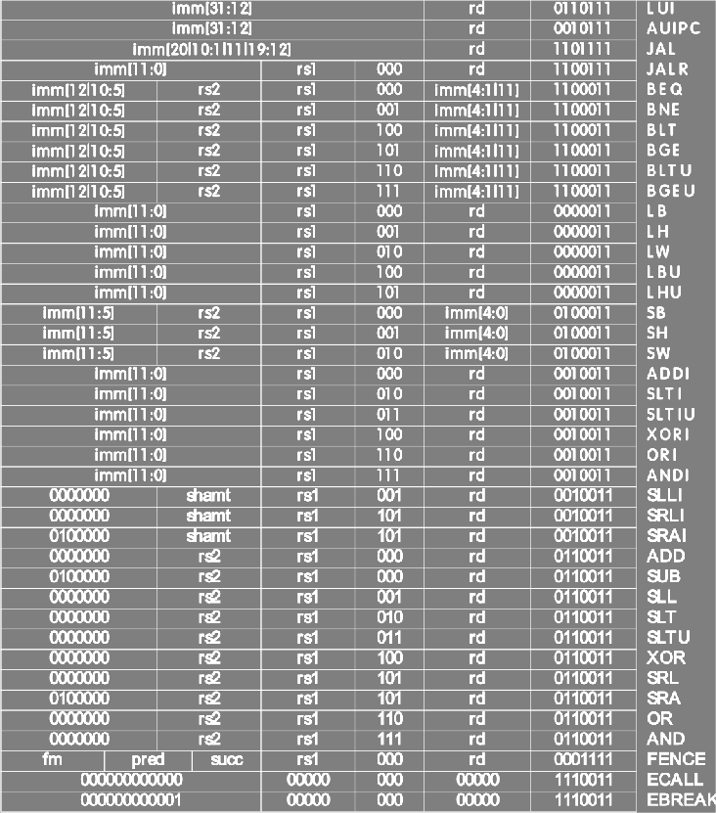
RV32I, A Nine-Bit ISA!
Instruction type encoded using only 9 bits:
inst[30], inst[14:12], inst[6:2]
inst[6:2] inst[14:12]
inst[30]

Slide 101
ROM-based Control
11-bit address (inputs)
Inst[30,14:12,6:2]
9
BrEq BrLT
PCSel ImmSel[2:0] BrUn
ASel BSel
ALUSel[3:0]
MemRW RegWEn WBSel[1:0]
ROM
3
4
2
15 data bits (outputs)

Slide 102
ROM Controller Implementation
AND
OR
add
Address Decoder
sub or
Control Word for add
Control Word for sub
Control Word for or
.
.
.
Inst[] BrEQ BrLT
.
.
.
11
jal
Controller output (PCSel, ImmSel, …)

Slide 103
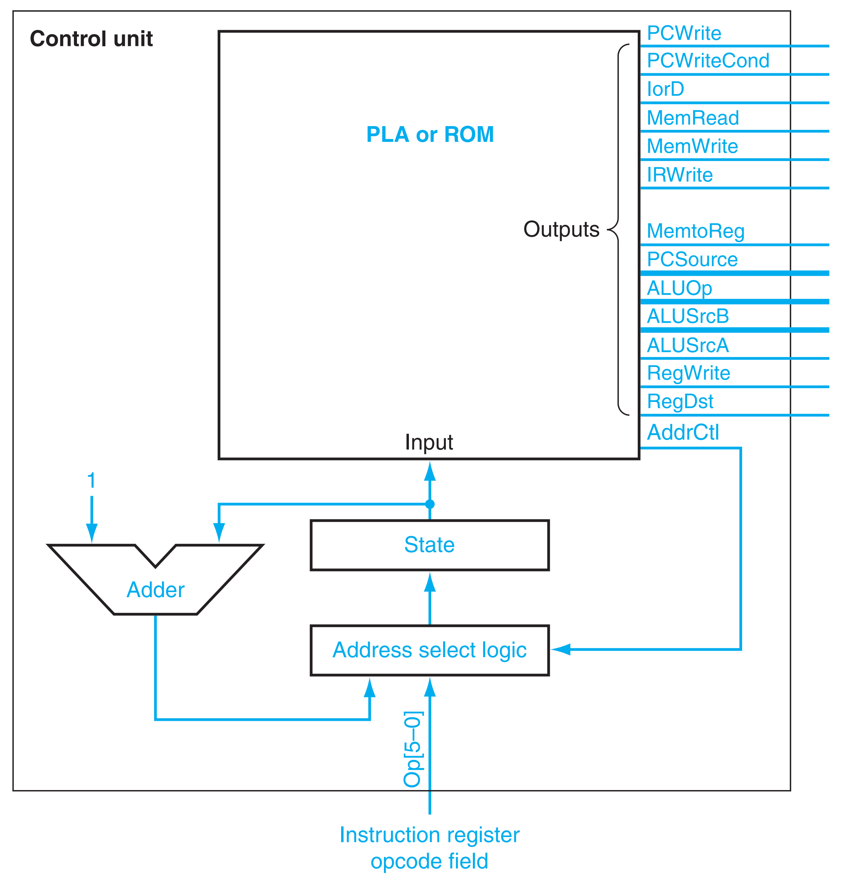
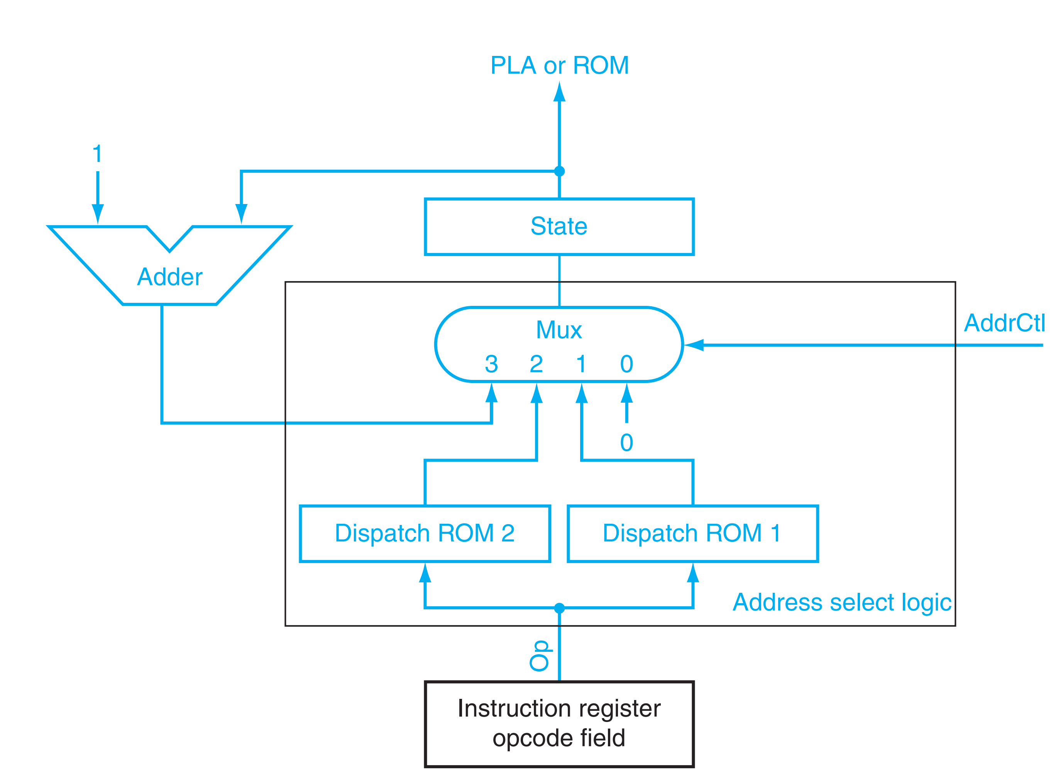
The control unit using an explicit counter to compute the next state

Slide 104
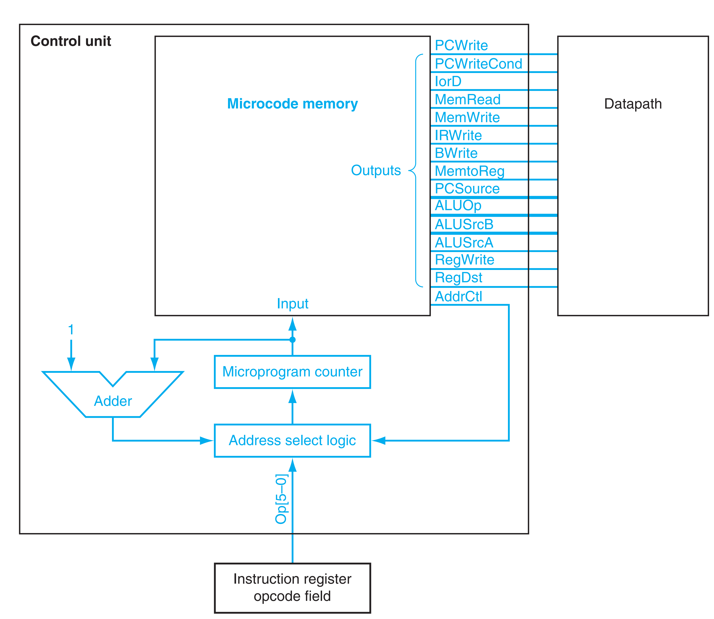

Slide 105




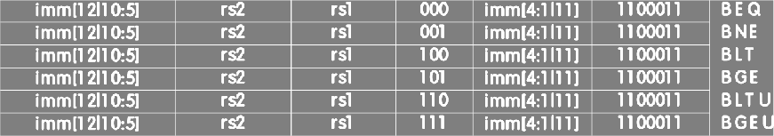
Combinational Logic Control
Simplest example: BrUn
inst[14:12]
inst[6:2]
How to decode whether BrUn is 1?
BrUn = Inst [13] • Branch

Slide 106


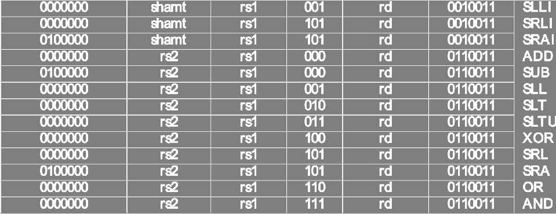
Control Logic to Decode add
add = i[30]•i[14]•i[13]•i[12]•R-type
inst[30] inst[14:12]
inst[6:2]
R-type = i[6]•i[5]•i[4]•i[3]•i[2]•RV32I
RV32I = i[1]•i[0]

Slide 107


Slide 108

Call home, we’ve made HW/SW contact!
High Level Language Program (e.g., C)
temp = v[k]; v[k] = v[k+1]; v[k+1] = temp;
lw x3, 0(x10)
Compiler
Assembly Language Program (e.g., RISC-V)
lw | x4, 4(x10)
sw | x4, 0(x10)
sw | x3, 4(x10)
1000 | 1101 | 1110 | 0010 | 0000 | 0000 | 0000 | 0000
1000 | 1110 | 0001 | 0000 | 0000 | 0000 | 0000 | 0100
1010 | 1110 | 0001 | 0010 | 0000 | 0000 | 0000 | 0000
1010 | 1101 | 1110 | 0010 | 0000 | 0000 | 0000 | 0100
Assembler
Machine Language Program (RISC-V)
Hardware Architecture Description
(e.g., block diagrams)
+4
Reg []
pc
1
Reg[rs1]
pc+4
alu
alu
1
pc
^{wb} DataD
₀ ALU
DMEM
2
IMEM
inst[11:7]
AddrD
Addr
1
pc+4 ⁰
inst[19:15] AddrA DataA inst[24:20] AddrB DataB
_{Branch} Reg[rs2] ₀
DataW
DataR
mem
wb
0
Architecture Implementation
Comp.
1
Logic Circuit Description (Circuit Schematic Diagrams)
inst[31:7] _{Imm.}
Gen
imm[31:0]
A
B
Out = AB+CD
C
D

Slide 109
“And In conclusion…”
We have built a processor!
Capable of executing all RISC-V instructions in one cycle each
Not all units (hardware) used by all instructions
Critical path changes
5 Phases of execution
IF, ID, EX, MEM, WB
Not all instructions are active in all phases
Controller specifies how to execute instructions
Implemented as ROM or logic

